Slide 1
Diffusion Tensor Imaging Analysis
Feb 1, 2023

Slide 2
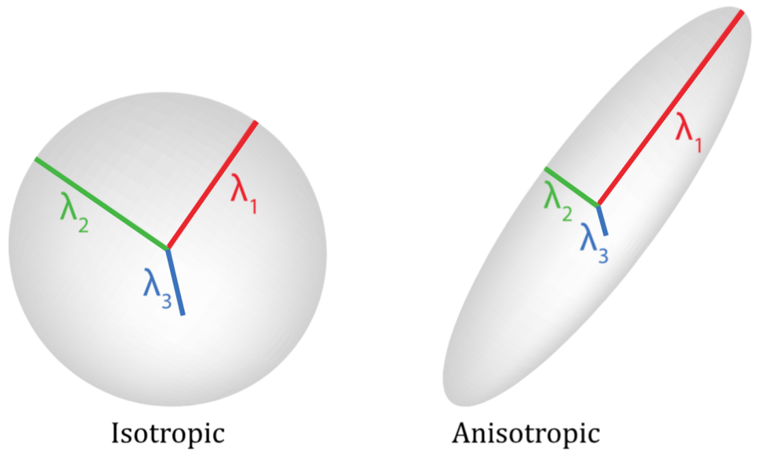
What is DTI?
Measuring the movement of water

Slide 3
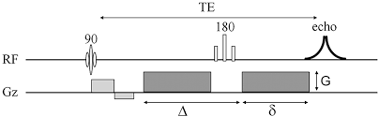
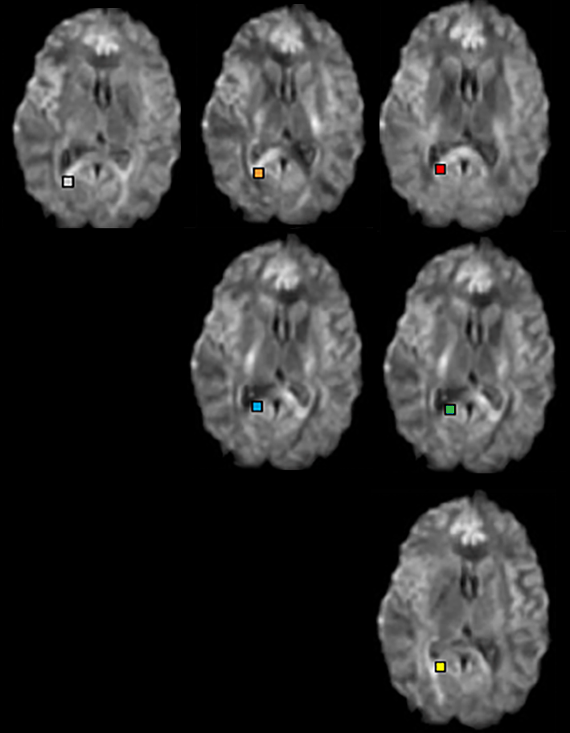
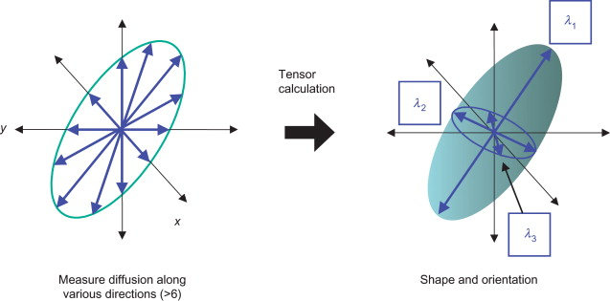
What is DTI?

Slide 4
DTI Data Collection
Important parameters:
Number and value of B(s)
# gradient directions
For Elition we have 3 suggested DTI sequences (see Dec meeting on Vbrain sequences)
HARDI 60
98 direction / 3 Bs
128 direction / 3 Bs

Slide 5
Analysis Pipelines
Depending on how you collect you data, you can use different analysis techniques.
For more advanced modelling, multi-shell diffusion (a few B values) is needed
To correct for image distortion due to EPI, need to collect B0 scans with opposite phase

Slide 6
Basic Analysis
For basic analysis I like to use FSL processing
- great wiki reference (and links within) at https://fsl.fmrib.ox.ac.uk/fsl/fslwiki/FDT/UserGuide#Processing_pipeline
Convert data (PAR/REC or dicom) to .nii using dcm2niix
- This should result in 4 files: .nii, .json, .bval, .bvec
Grab the B0 image(s)
fslroi DTI.nii B0.nii 0 1
Depending on if you do distortion corrections, the next steps are different.

Slide 7
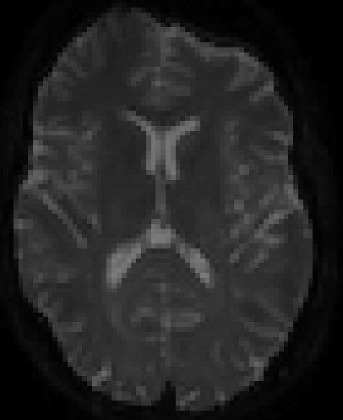
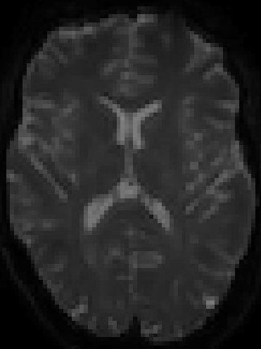
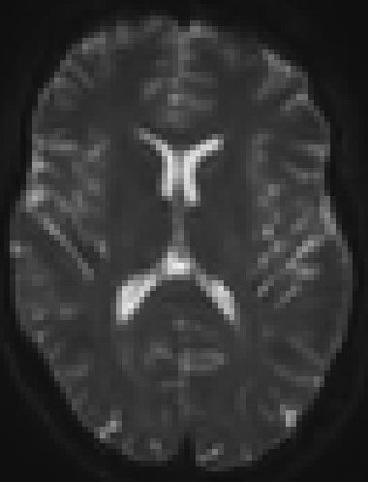
Topup or no Topup?
B0 image
Reverse phase
Topup corrected

Slide 8
No Topup
3. Brain extract the B0
> bet B0.nii B0_brain –f 0.2 –g 0 –m
4. Create acqparam and index files
> acqparam.txt describes images in DTI file (specifying the phase-encoding direction). Index.txt links acqparam and DTI files.
5. Do eddy current correction
> eddy_openmp --imain=DTI --acqp=acqparams.txt --index=index.txt –mask=B0_brain_mask --bvals=…bval --bvecs=…bvec --out=DTI_NO_TU
6. Run tensor analysis
> dtifit --data=DTI_NO_TU --out=DTI --mask=mask=B0_brain_mask --bvals=…bval --bvecs=DTI_NO_TU.eddy_rotated_bvecs

Slide 9
Using TopUp
3. Merge B0
> fslmerge –t DTI_b0_all DTI_b0 DTI_reverse
4. Find Topup values
> topup --imain=DTI_b0_all --datain=acqparams.txt --config=b02b0.cnf --out=topup_PA_AP_b0 --fout=topup_PA_AP_b0_field --iout=topup_PA_AP_b0_unwrapped
5. Apply topup
> applytopup --imain=DTI_b0,DTI_reverse --inindex=1,2 --datain=acqparams.txt --topup=topup_PA_AP_b0 --out=topup_hifi_nodiff
6. BET
> bet topup_hifi_nodiff topup_hifi_nodiff_brain -m -f 0.2
7. Eddy current correct
> eddy_openmp --imain=DTI --mask=topup_hifi_nodiff_brain_mask --datain=acqparams.txt --index=index.txt --bvals=…bval --bvecs=…bvec --out=ECC --ref_scan_no=0 --ol_nstd=4 --topup=topup_PA_AP_b0
8. Run tensor analysis
> dtifit --data=ECC --out=DTI --mask=topup_hifi_nodiff_brain_mask --bvals=…bval --bvecs= ECC.eddy_rotated_bvecs

Slide 10
Acqparams and Index files
Acqparams refers to how the data was acquired (one line for each B0 image)
0 -1 0 0.01
0 1 0 0.01
Index file links the imain file to the acqparams file
single row with 1 entry per volume in imain pointing to which line of acqparams it was acquired as
> fslnvols DTI (can help determine how many entries in index)
first 3 entries are direction of phase encoding, last is total readout time

Slide 11
Issues with topup
It seems that the config file b02b0.cnf expects the DTI file to have an even number of slices.
FMRIB has now created other config files:
b02b0_4.cnf -- data is multiple of 4 in all directions
b02b0_2.cnf -- data is multiple of 2 in all directions
b02b0_1.cnf -- data is odd in one or more directions

Slide 12
What is output?
After running dtifit, you get 10 parameter files:
3 eigenvalues (L1, L2, L3)
3 eigenvectors (V1, V2, V3)
fraction anisotropy (FA)
mean diffusivity (MD)
mode of the anisotropy (M0)
raw T2 signal with no diffusion weighting (S0)

Slide 13
Now what?
Get mean and standard deviation values from an ROI
> fslstats DTI_XX.nii.gz -k ROI.nii.gz -m -s
Parameters of interest
FA - measures degree of anisotropy (0=iso, 1=aniso)
MD - average diffusion measure
L1 - axial diffusivity (along tract direction)
Average (L2, L3) - radial diffusivity (perpendicular to axon)

Slide 14
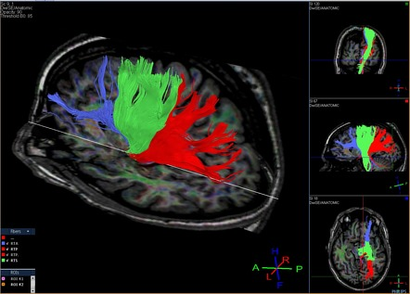
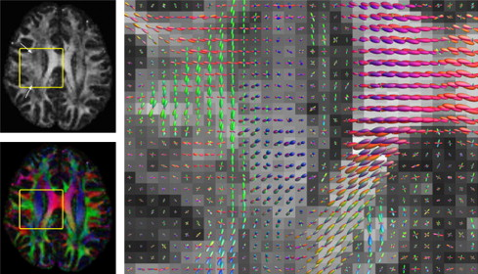
Tractography
By following the principal diffusion direction, we can map the length of a fibre tract.

Slide 15
Tractography
In FSL, first run BEDPOSTX then PROBTRACKX
> bedpostx subject_directory
(the directory will need to contain bval and bvec files, data file, brain mask)
(expect BEDPOSTX to run a long time)
> probtrackx -s basename -m maskfile -x seedfile -o output
These commands can also be run within the FSL GUI which may be more straightforward.

Slide 16
Multi-B shell modeling
A number of different approaches
DBSI (Diffusion Basis Spectrum Imaging)
NODDI (Neurite Orientation Dispersion and Density Imaging)
DKI (Diffusion Kurtosis Imaging)
…

Slide 17
Next meeting
March 1st

